Slide 1

Mark Lenz, PE
Cornell Career Conversations | Sr Vice President | Sep 2019

Slide 2

My Path – by the #’s
1 company, 2 business models (23 yrs)
3 offices (WHI, NYC, BUF)
~ 10 roles (Proj Eng, DPM/PM, PIC, PMO, Op’s Mgr, Corp H&S, Area Leader)
~20 Conference Presentations (2 Peer Reviewed Journals)
0.34 TRIR (lowest in Company History)
58 = size of current team
26 States (2 Provinces)
~$7 Billion of Drinking Water Assets
>32 Million Population Served (~10% of US Population)

Slide 3
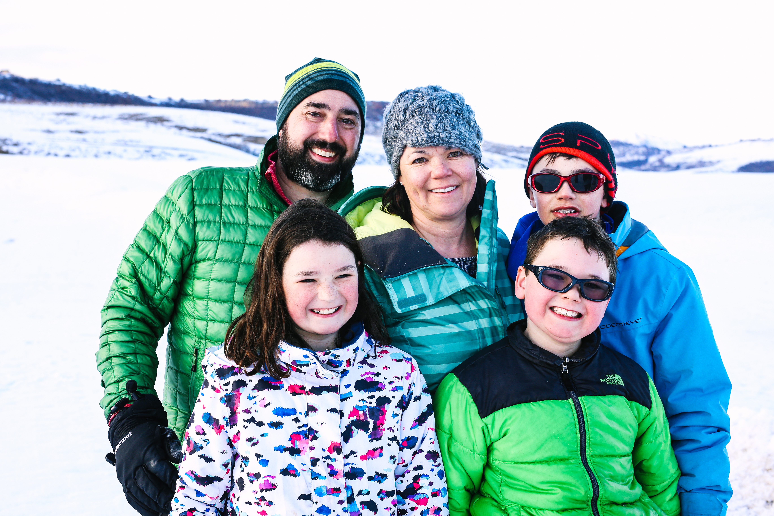
My Path (by the #’s)
1 wife (19 yrs)
3 kids (16, 14 & 11)
30 Ski Days a Year
40 miles of canoeing & camping
46 states (missing ND, OK, AR, LA & MS)
I LOVE hanging out with family, friends, cooking, skiing, camping, hiking & hazy NE IPA’s

Slide 4

Improving
quality of life.

Slide 5
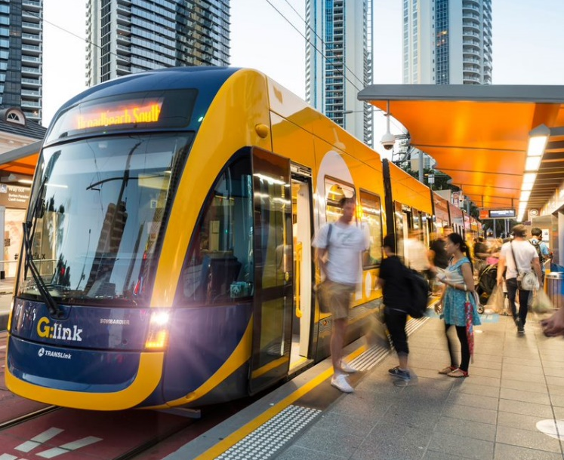
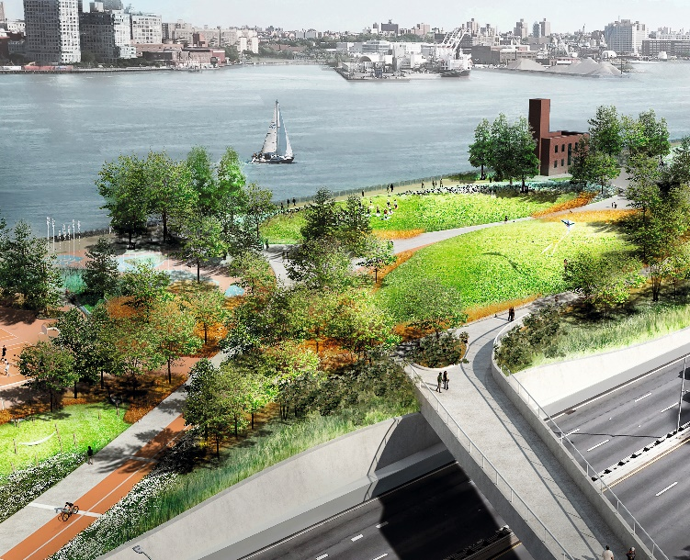






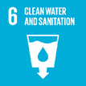

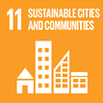


Trends & SDG’s
The world we live in challenges us
Urbanization
& Mobility
Sustainability & Climate Change
Globalization
Digitization
Sustainable Development Goals

Slide 6
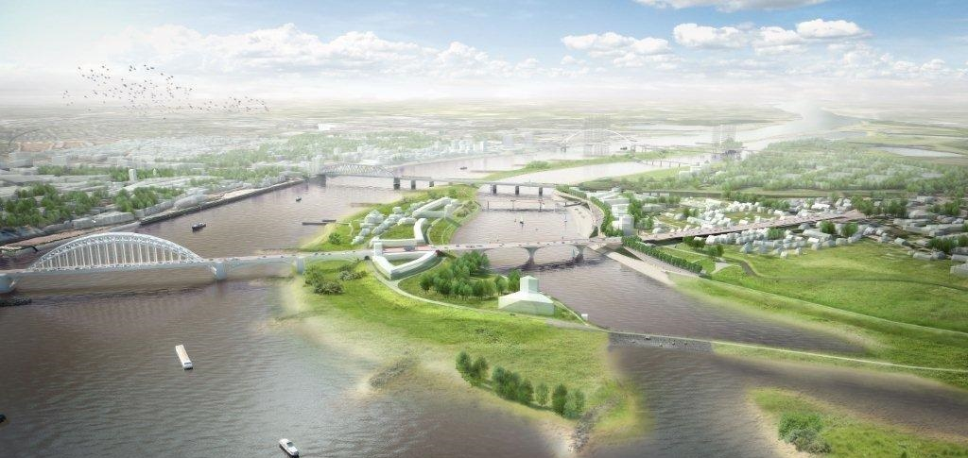
To help you navigate and thrive
we design and consult
Sustainable and resilient cities
Smart infrastructural solutions
Future-proof industries

Slide 7
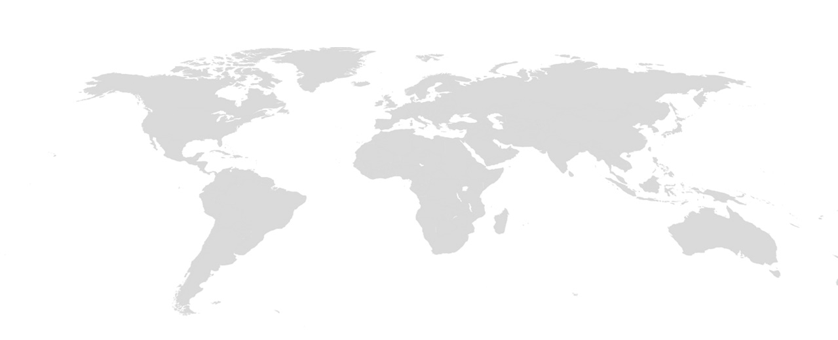
6,264
Employees in Europe
4,434
5,197
Employees in the UK
Employees in North America
4,304
1,438
2,175
Employees in Asia
Employees in Latin America
Employees in the Middle East
2,175
Employees in Australia Pacific
About Arcadis
Local strength,
global reach
27,327
70+
40+
3.5B
Employees worldwide
Countries with
Completed projects
Countries with offices
Euro Revenues in 2017
1,712
Callison/RTKL

Slide 8





People First
Strong cultural values
Collaboration
Client Success
Sustainability
Integrity

Slide 9
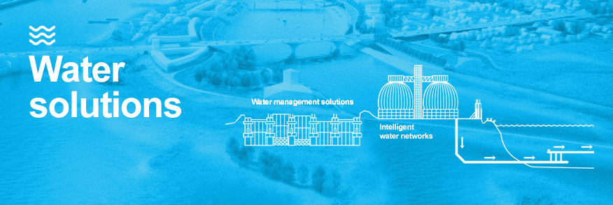
Water focuses on the entire water cycle; from source to tap and then back to nature. Through our wealth of experience in the water sector, Arcadis specialist teams of engineers, scientists, and consultants are uniquely positioned to provide safe and secure water technology and innovations that are built to withstand the demand of a rapidly changing world. In addition, our water management capabilities, originating from our Dutch heritage of living with the sea, are world-renowned and are now applied in many coastal areas around the world to increase urban resilience. Arcadis is a global top-five player in water services.

Slide 10
Questions/Discussion

Slide 11
Questions from Monroe
Has climate change entered in the conversations about how to provide environmental engineering solutions for clients?
Has resilience or sustainability entered into the conversations with clients? I've been reflecting that critical infrastructure could be designed to be resilient with minimal requirements for specialized components so that it can be brought back on line quickly after any type of disaster. Is this concept of interest to clients?
What skills or experiences would you like engineers to have before the come to Arcadis that Cornell grads don't currently bring? How could we do better at educating our students?
What skills or experiences are Cornell students bringing to Arcadis that you find particularly beneficial? This is an opportunity to encourage students to get the kinds of experiences that will be helpful for their careers.

Slide 12
